Slide 1
PROBABILTY
PROBABILTY IS A NUMBER THAT REFLECTS THE CHANCE THAT A PARTICULAR EVENT WILL OCCUR.
PROBABILTY IS A NUMBER BETWEEN ‘0’ AND ‘1’
0 = IMPOSSIBLE
1= CERTAINTY
FORMULA -:
PROBABILITY= WAYS/OUTCOMES
WHERE
WAYS- THE NUMBER OF WAYS IT CAN HAPPEN.
OUTCOMES- THE NUMBER OF POSSIBLE OUTCOMES.

Slide 2
MUTUALLY EXCLUSIVE EVENT-:
THE EVENT IF THEY BOTH CAN NOT OCCUR AT THE SAME TIME IS CALLED A MUTUALLY EXCLUSIVE EVENT.
FORMULA-: P(A OR B)= P(A)+P(B)
WHERE A OR B ARE TWO MUTUALLY EXCLUSIVE EVENTS.
EXAMPLE-:
SO THERE IS NO INTERSECTION PART BETWEEN A AND B.
A
B

Slide 3
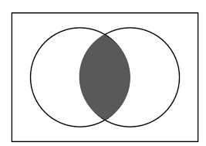


MUTUALLY INCLUSIVE/ NON- MUTUALLY EXCLUSIVE EVENTS-:
THIS EVENT CAN HAPPEN AT THE SAME TIME OR OCCUR IN A SINGLE TRIAL IS CALLED MUTUALLY INCLUSIVE EVENTS.
FORMULA-: P(A OR B)= P(A)+P(B)- P(A B)
WHERE -:
P(A)- PROB. OF A
P(B)-PROB. OF B
P(A $∩$ B)- INTERSECTION PART / COMMON PART OF A AND B
HH IN THE VENN DIAGRAM, THE OVERLAPPING PART = P(A$∩B$) )
$$∩$$
A
B

Slide 4
INDEPENDENT EVENT
DEPENDENT EVENT
TWO EVENTS ARE INDEPENDENT IF THE OUTCOMES OR OCCURRENCE OF THE FIRST DOES NOT AFFECT THE OUTCOME OR OCCURRENCE OF THE SECOND.
P(A & B)= P(A) * P(B)
EXAMPLE- FLIP A COIN AND WE WILL GET HEAD, AGAIN WE FLIP THE SECOND COIN WE WILL GET TAIL, SO BOTH COIN DID NOT AFFECT EACH OTHER.
TWO EVENTS ARE DEPENDENT IF THE OUTCOME OF THE FIRST EVENT AFFECTS THE OUTCOME OF THE SECOND EVENT.
P(A & B)= P(A) * P(B/A)
P(A & B)= P(B) * P(A/B)
P(A)- PROB. OF A
P(B)- PROB. OF B

Slide 5
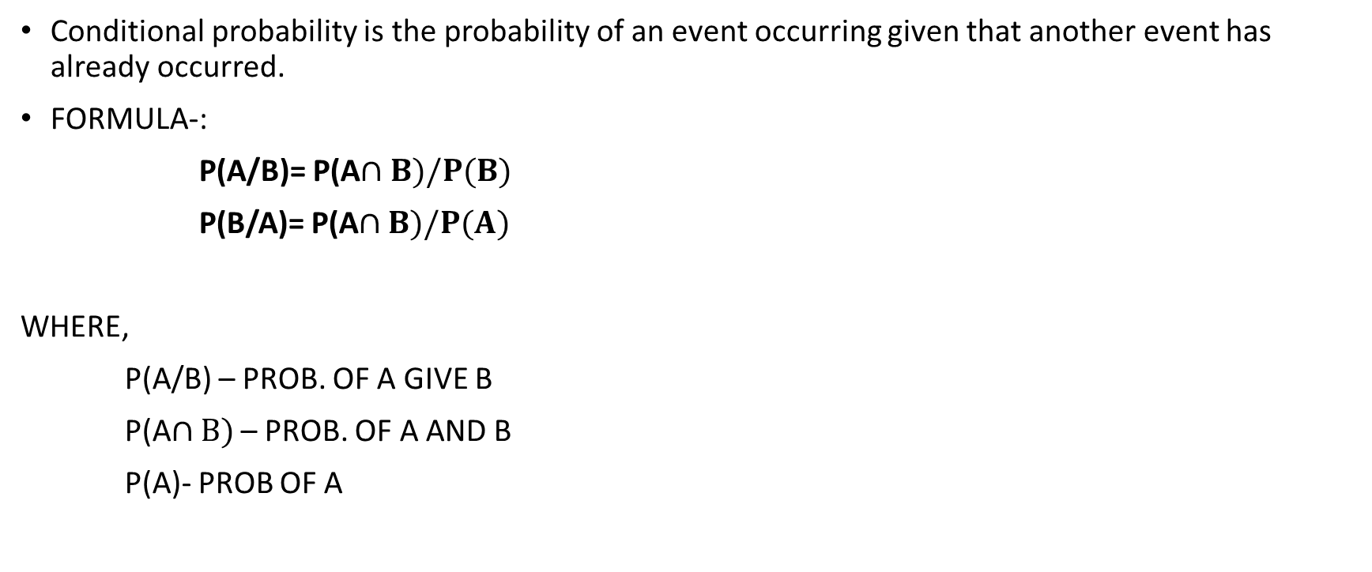
CONDITIONAL PROBABILITY -:
Conditional probability is the probability of an event occurring given that another event has already occurred.
FORMULA-:
P(A/B)= P(A$∩B)/P(B)$
P(B/A)= P(A$∩B)/P(A)$
WHERE,
P(A/B) – PROB. OF A GIVE B
P(A$∩B)$ – PROB. OF A AND B
P(A)- PROB OF A

Slide 6
BAYE’S THEOREM
Another way of calculating conditional probability is by using the Bayes’ theorem. The theorem can be used to determine.
P(A/B) = [P(B/A)*p(A)]/P(B)
the conditional probability of event A, given that event B has occurred, by knowing the conditional probability of event B,
given the event A has occurred, as well as the individual probabilities of events A and B.

Slide 7
Q.)Let X and Y are two independent events such that P(X) = 0.3 and P(Y) = 0.7. Find P(X and Y)
P(X)=0.3 AND P(Y)= 0.7
PUT THE VALUE IN FORMULA
P(A & B)= P(A) * P(B)
P(X AND Y)= 0.3 * 0.7 =0.21
P(X AND Y) =21%

Slide 8
Q.) What is the probability of spinning a prime number or an odd number on a spinner numbered 1 to 8?
S={1,2,3,4,5,6,7,8} (SO THIS IS A NON-MUTUALLY EXCLUSIVE EVENT)
TOTAL OUTCOMES= 8
PRIME NUMBERS = {2,3,5,7} P(P)= 4/8
ODD NUMBERS= {1,3,5,7} P(O) = 4/8
P(P AND 0)= {3,5,7} =3/8 FORMULA- : P(A OR B)= P(A)+P(B)- P(A B)
PUT THE VALUE IN FORMULA
P(P AND O)= 4/8 + 4/8 – 3/8
P(P AND O)= 5/8

Slide 9
Q.)For numbers, one to nine, find the probability of getting a number 2 or no. less than 4?
TOTAL NUMBERS- {1,2,3,4,5,6,7,8,9}
PROBABILITY OF GETTING NO 2 P(2)= 1/9
PROBABILITY OF GETTING LESS THAN 4 P(<4)= 3/9
PROB. OF BOTH AT SAME TIME = 1/9
FORMULA= : P(A OR B)= P(A)+P(B)- P(A B)
SO
P(2 AND <4) = 1/9+3/9-1/9
P(2 AND <4)= 3/9 OR 1/3

